Slide 1
Neural Network [1]
Joohyung Lee

Slide 2
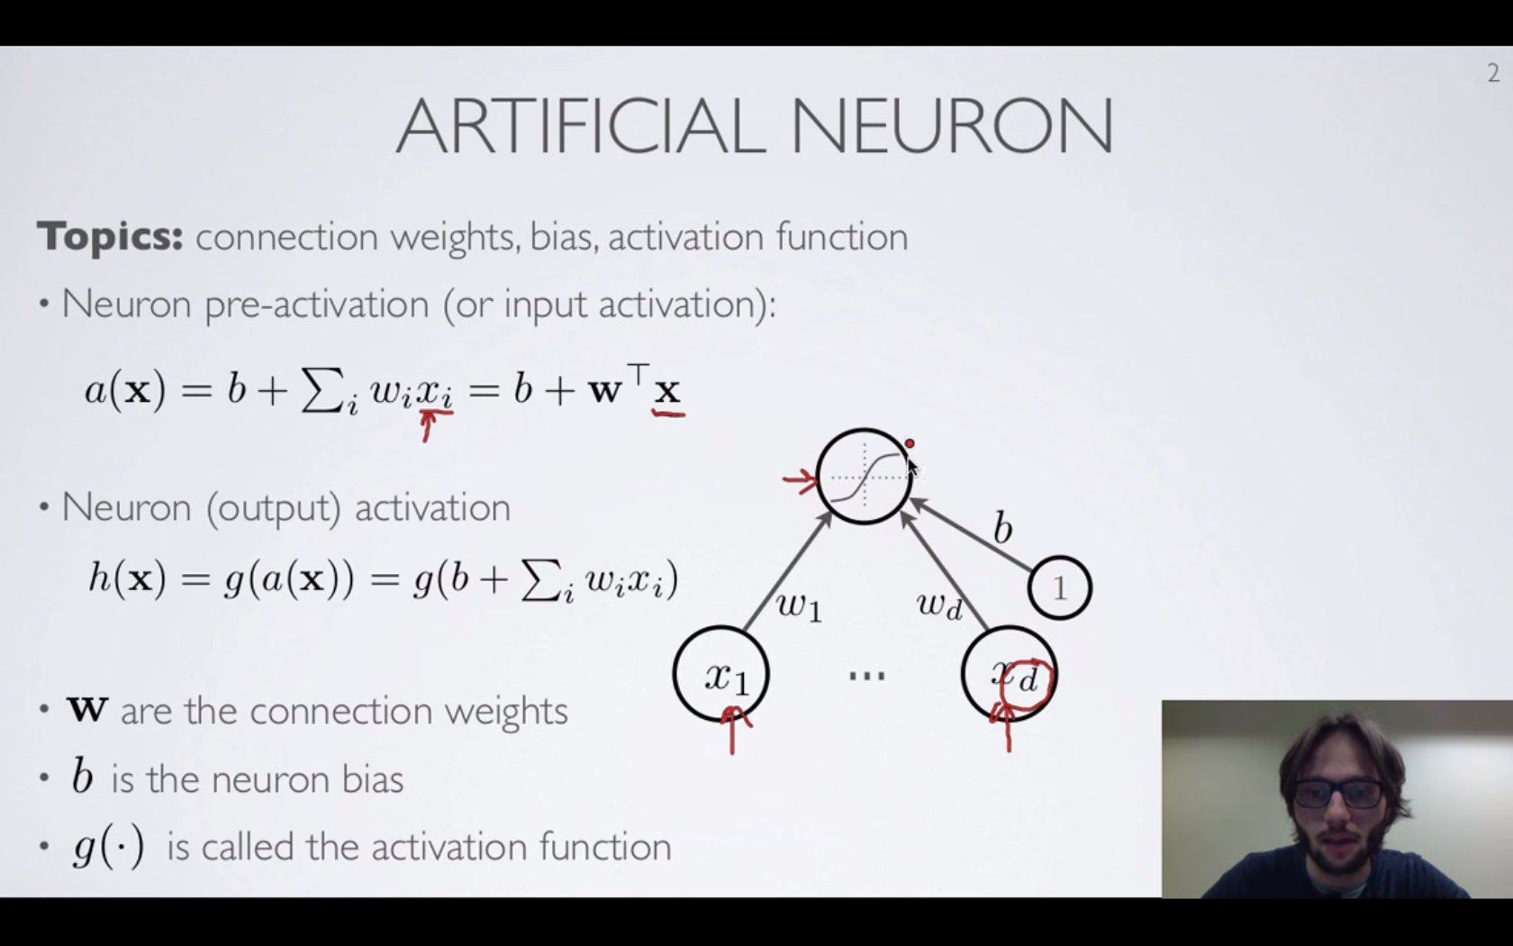
Intro

Slide 3
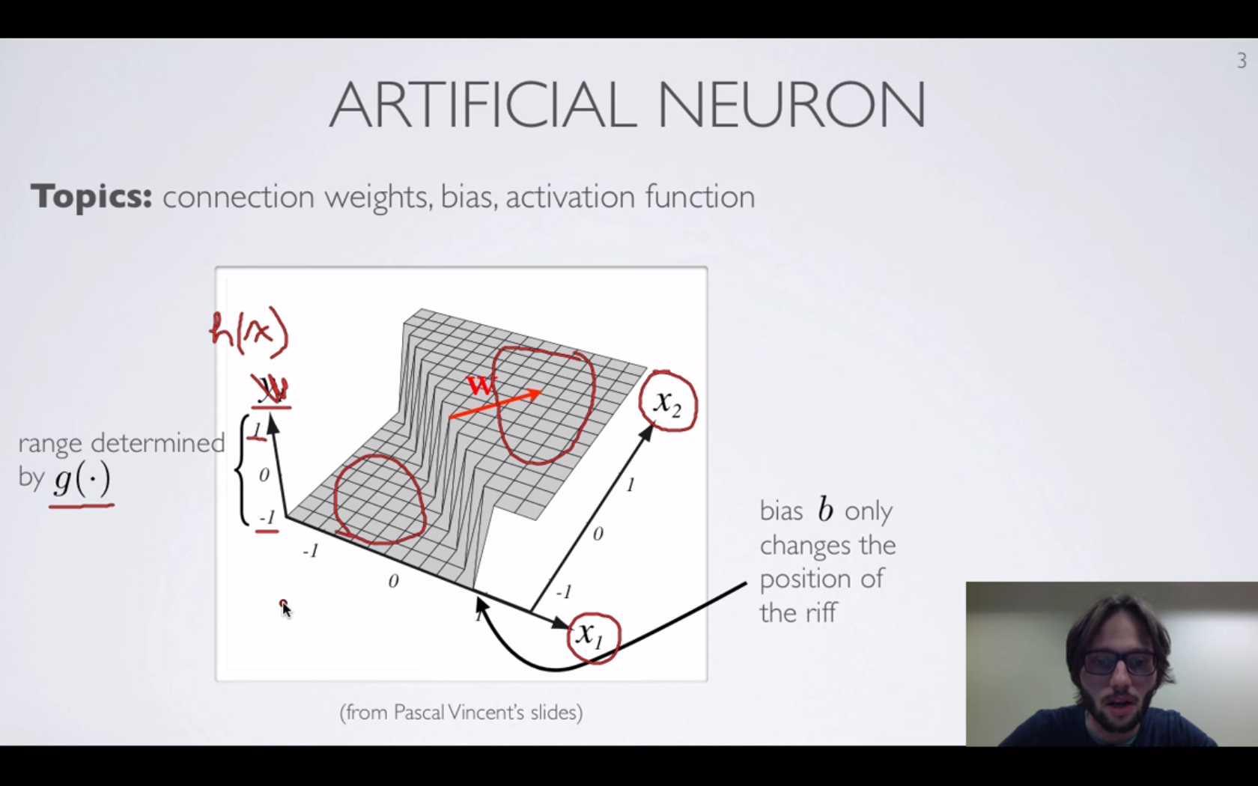
Sigmoid

Slide 4
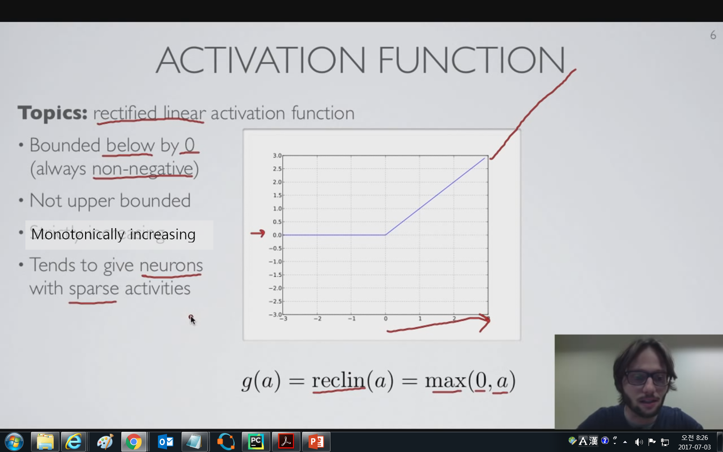
ReLU

Slide 5
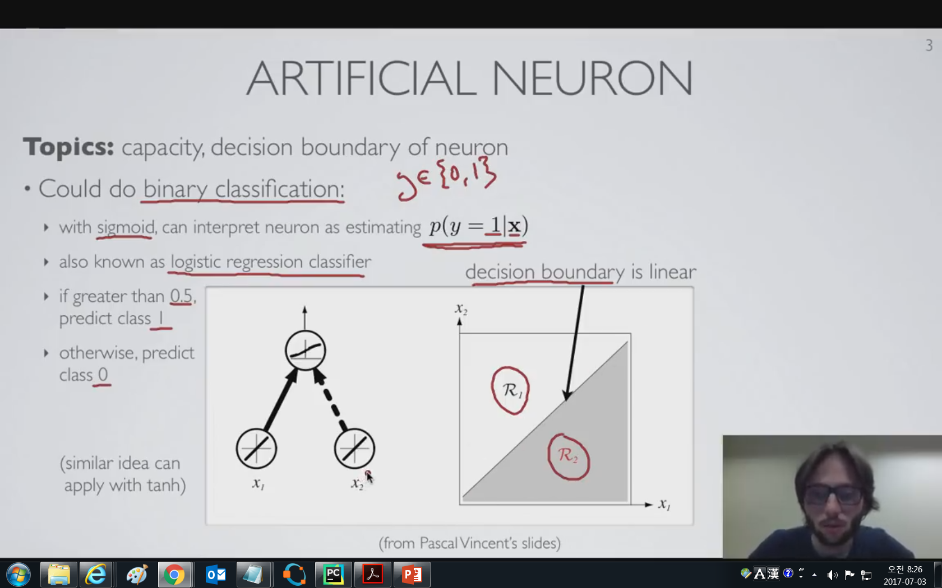
Neuron Capacity

Slide 6
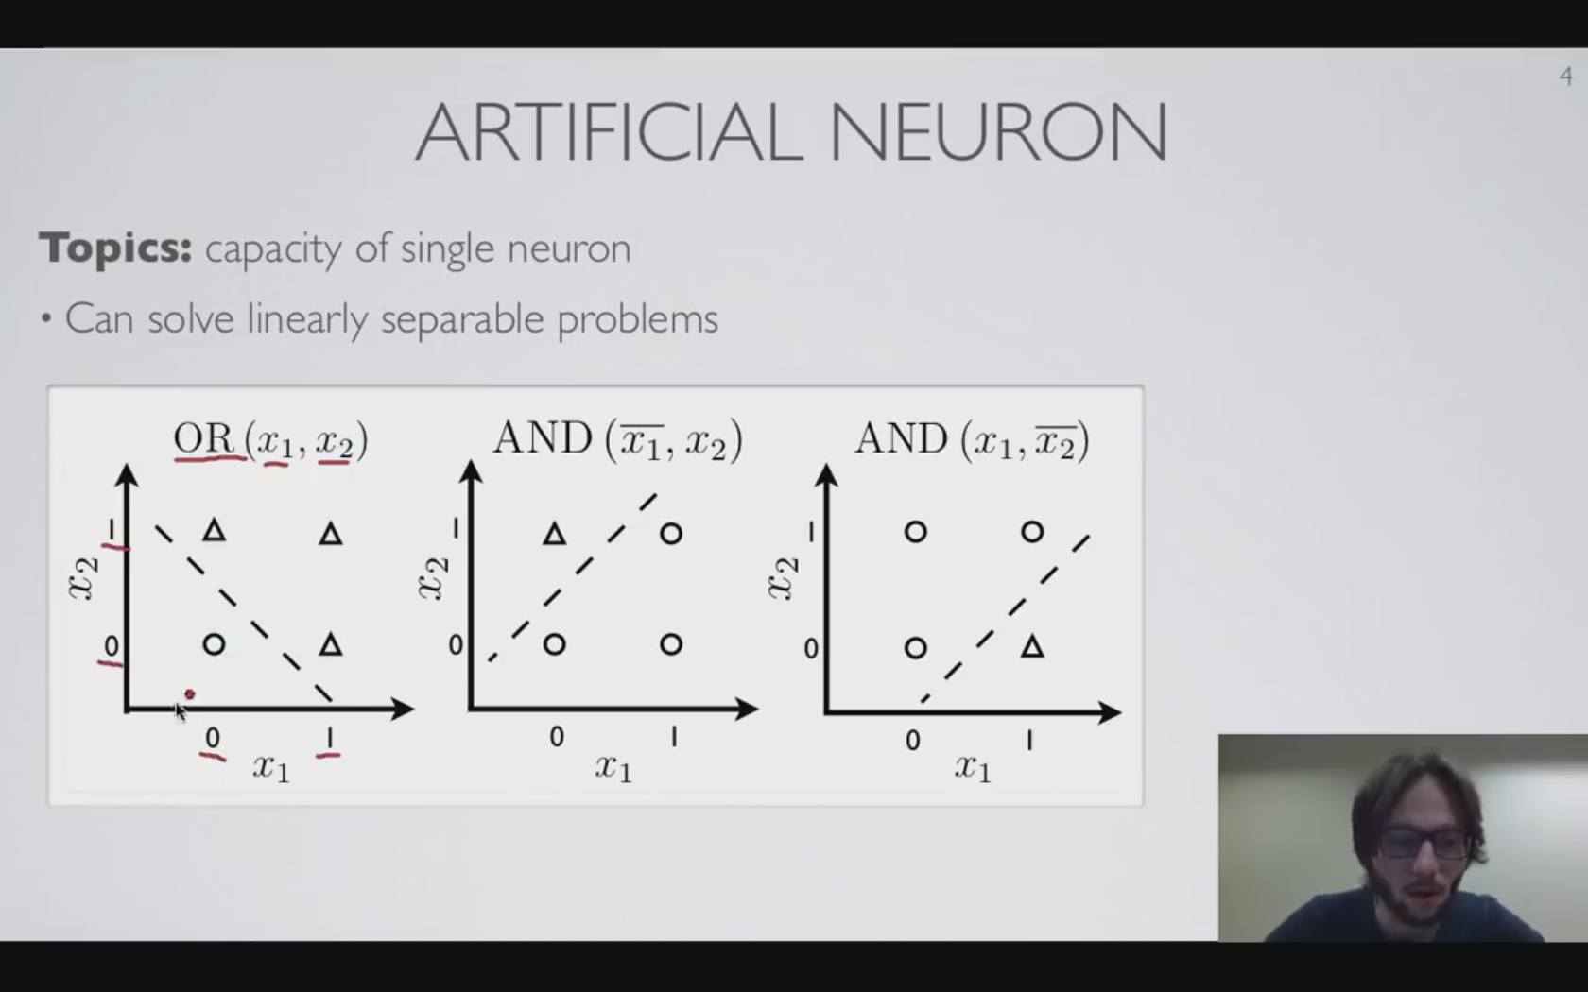
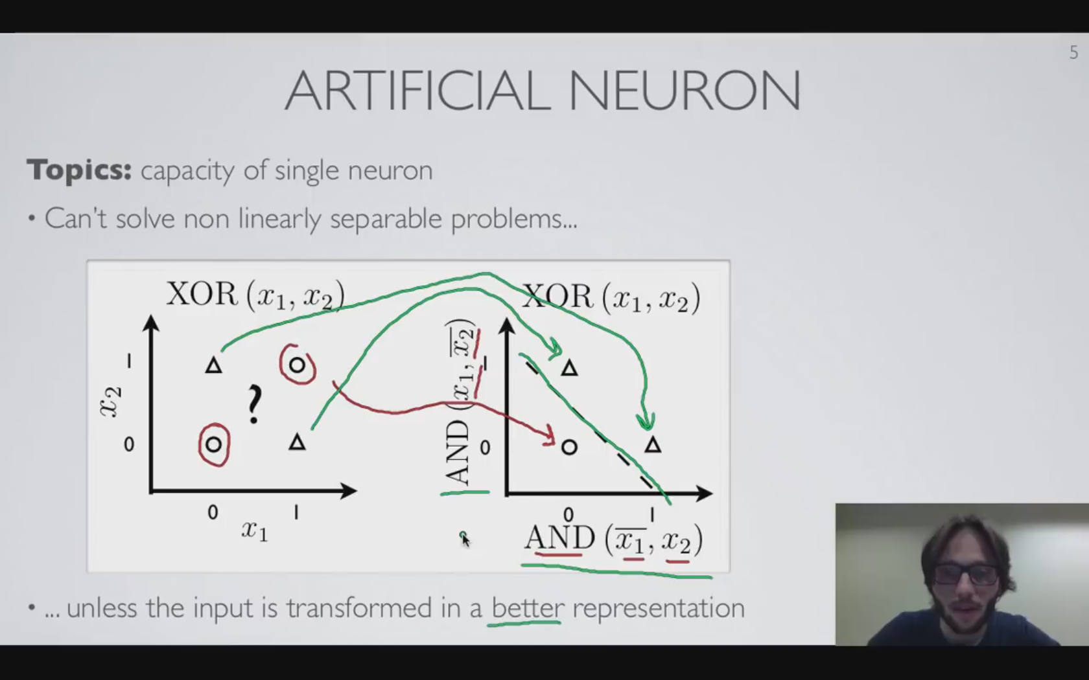
Limit of the single layer NN
Inspiration for a transformation: calls for a multi-layered neural network

Slide 7
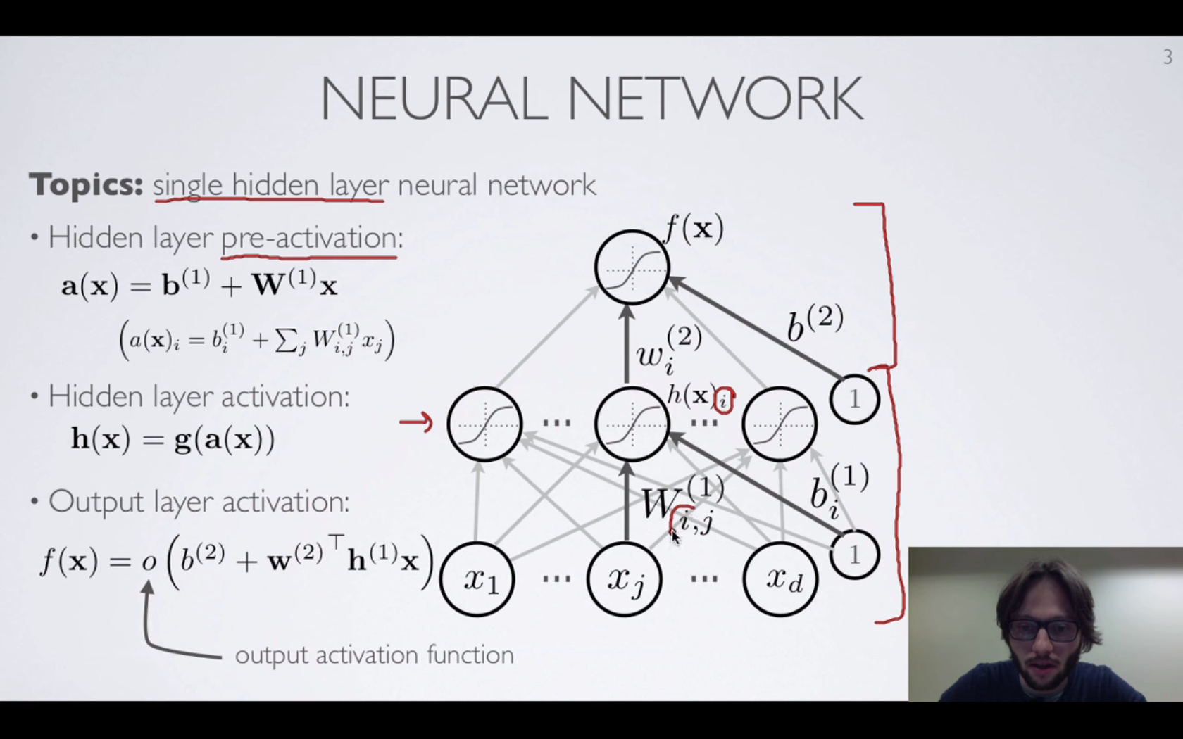
Single hidden layer -more linearly separable representation

Slide 8
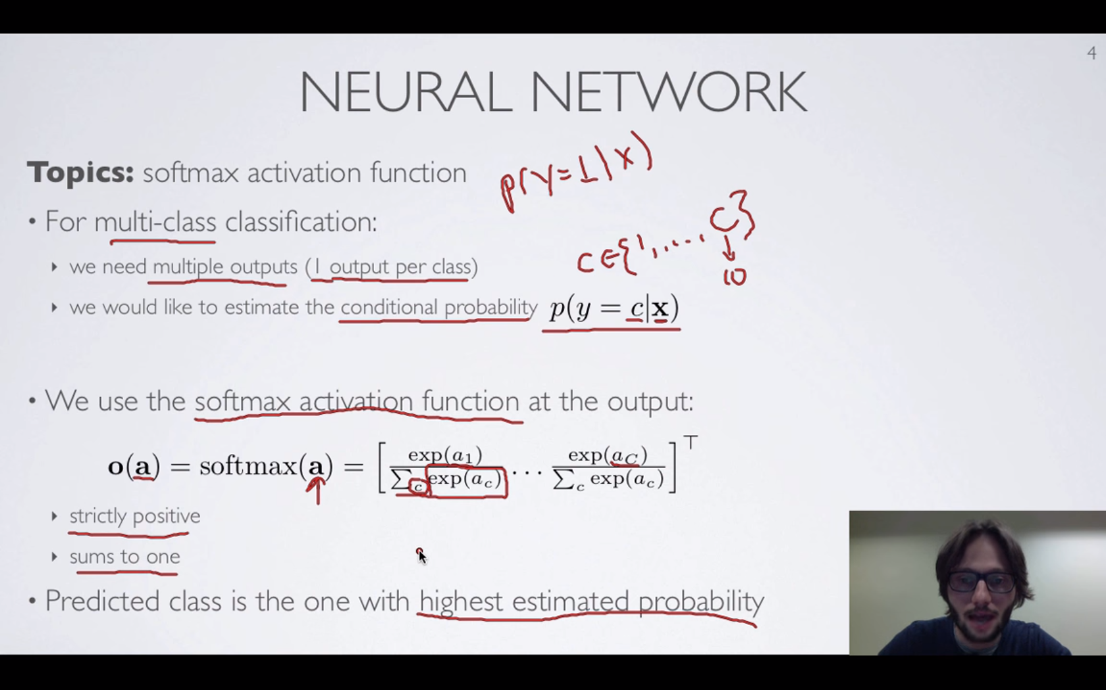
Softmax: multi-class classification

Slide 9
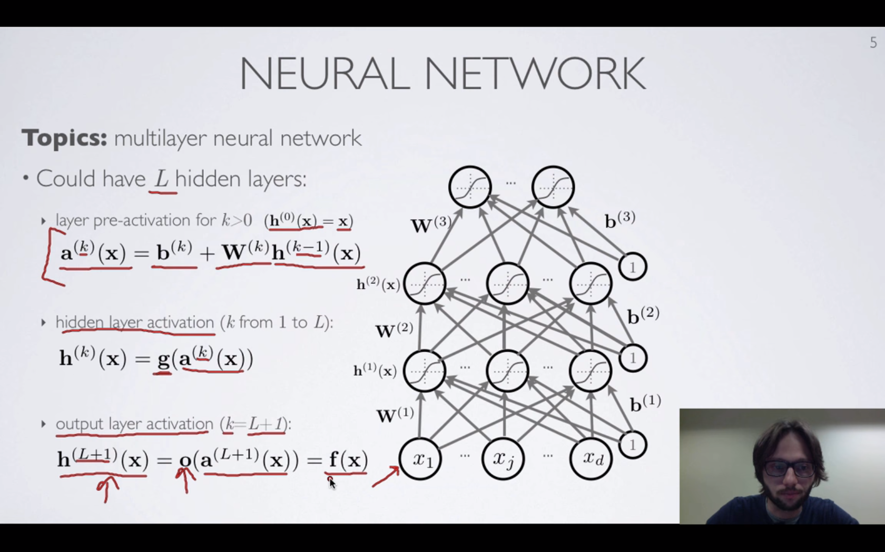
Multi-layer NN

Slide 10
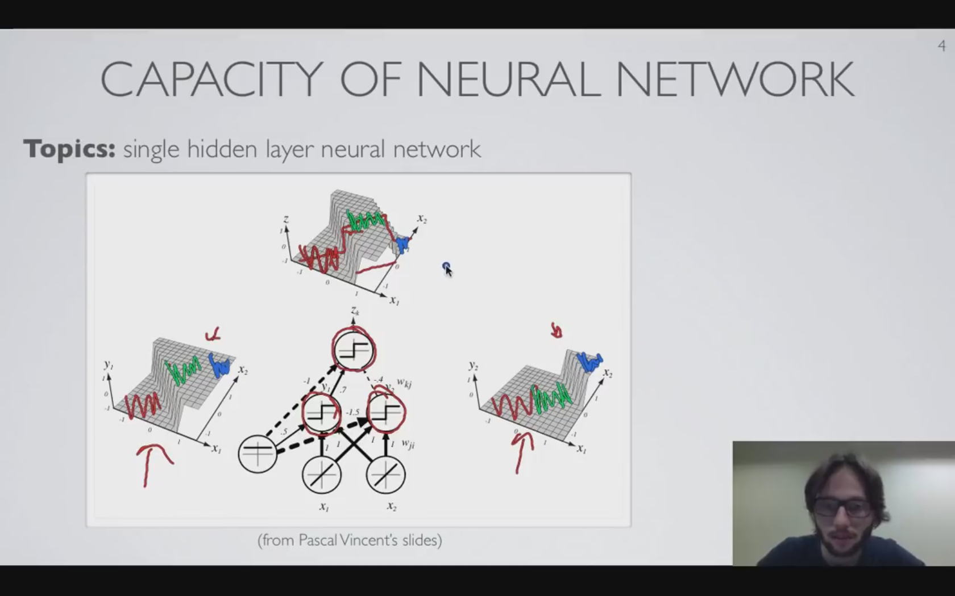
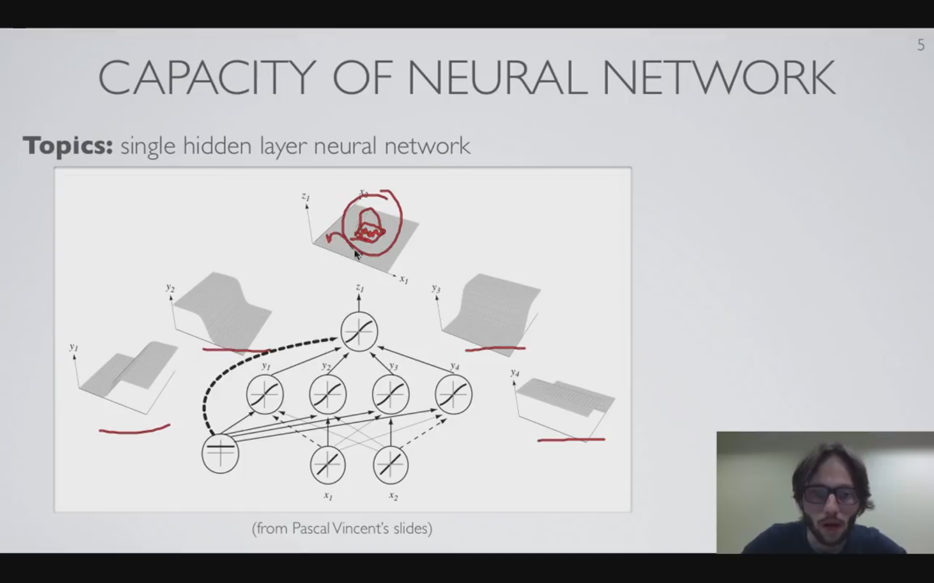
Capacity of multi-layered NN

Slide 11
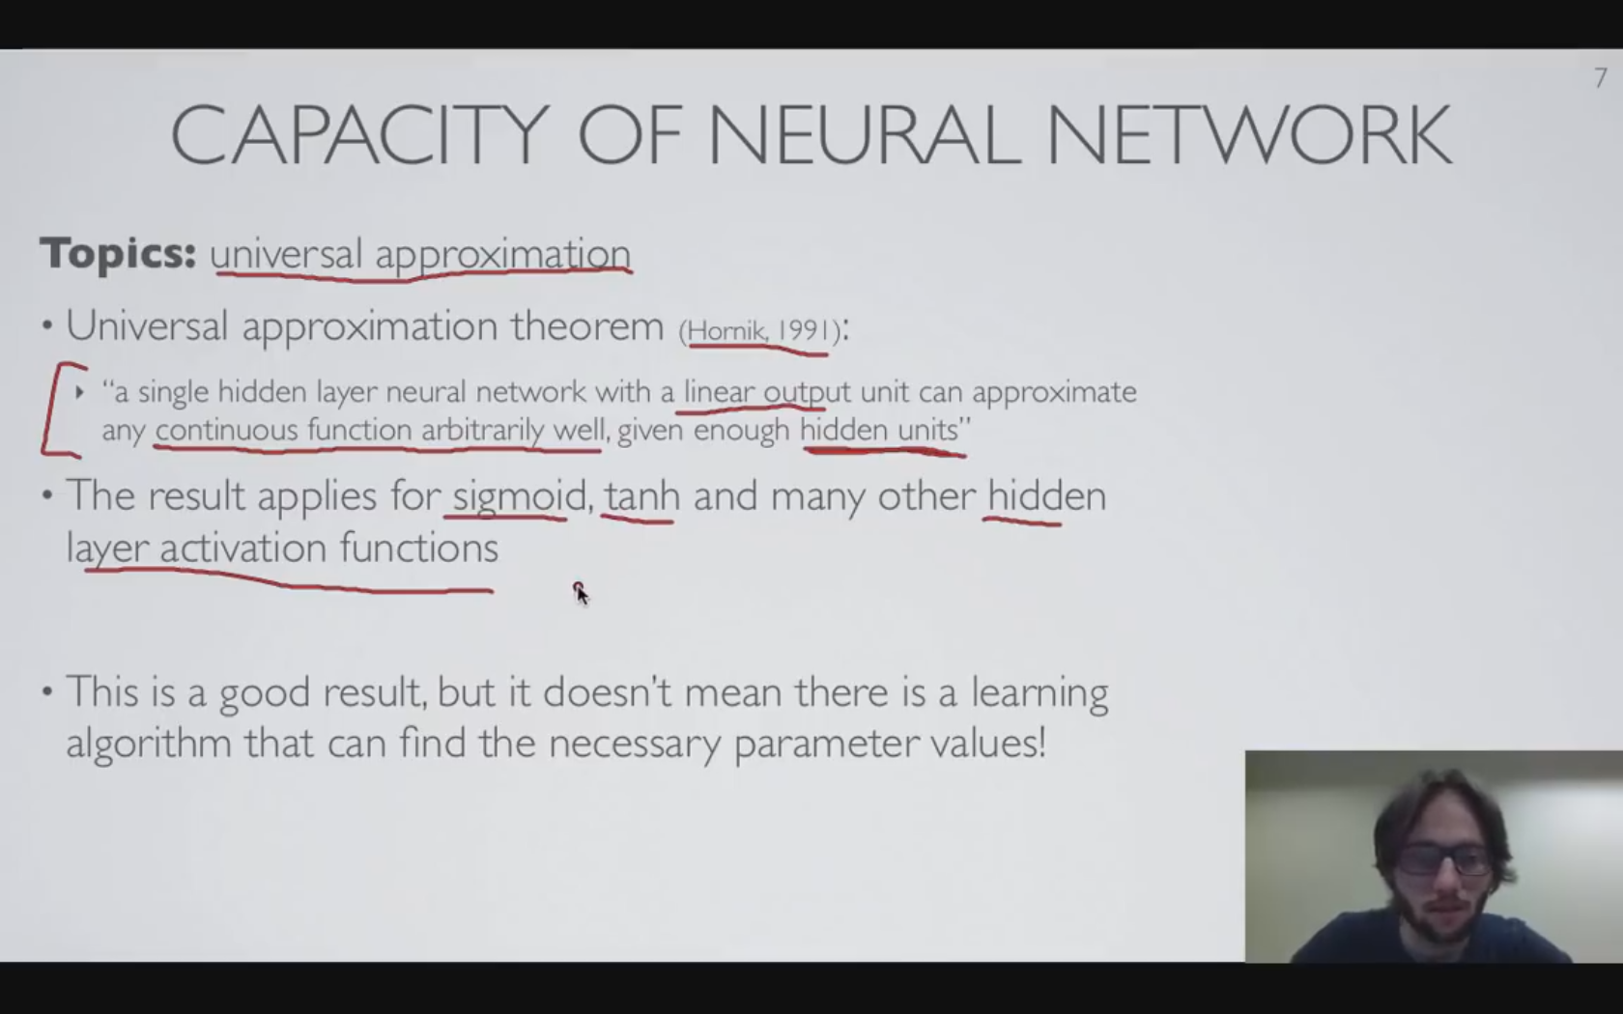
Formal Justification

Slide 12
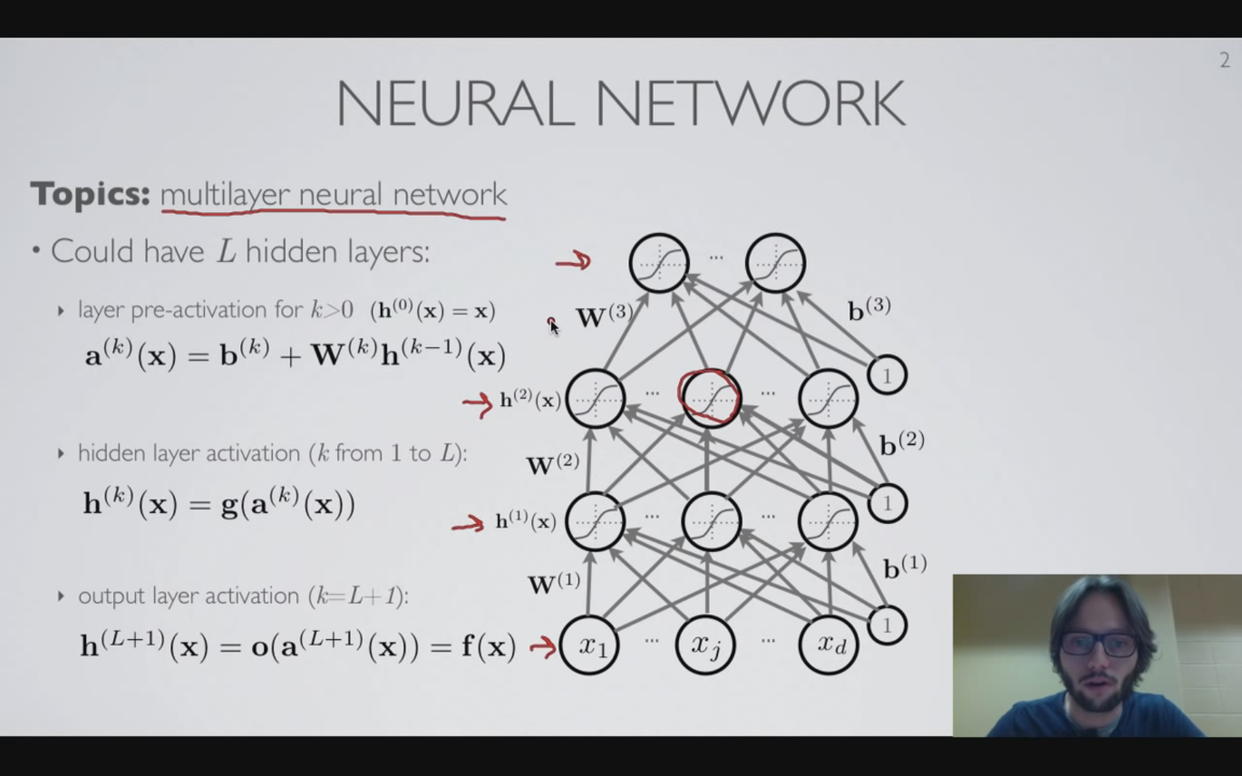
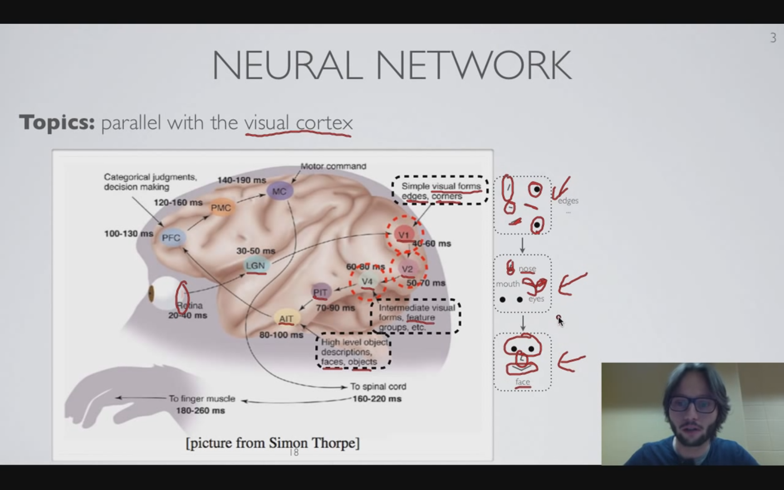
NN: Biological Inspiration
Visual Cortex: interprets the ‘visual stimuli’ from retina
Sequential processing

Slide 13
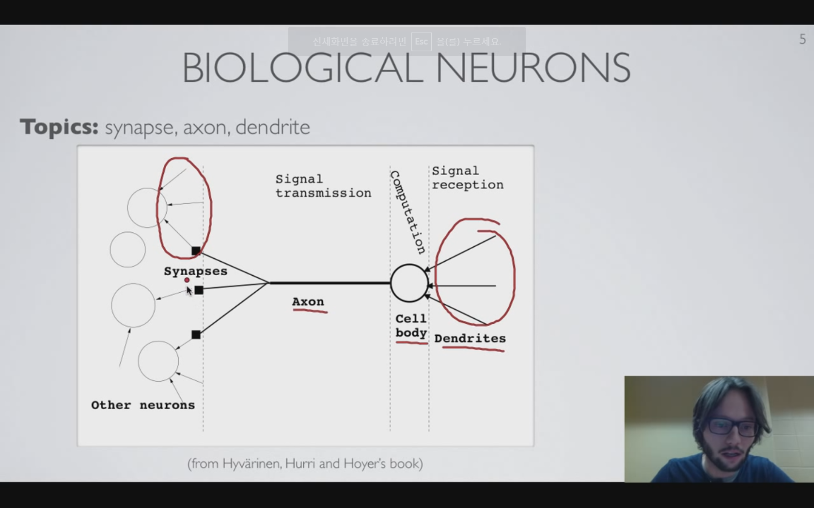
Synapse, axon, dendrite
Intensity represented by ‘Firing rates’ of a neuron

Slide 14
References
From “Neural Networks” by Hugo Larochelle. Lec 1.1~1.6
https://www.youtube.com/user/hugolarochelle

